Slide 1
70-533 : Implementing Microsoft Azure Infrastructure Solutions

Slide 2
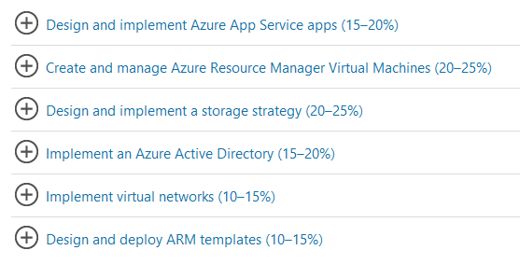
70-533 : Implementing Microsoft Azure Infrastructure Solutions

Slide 3
Configure VN

Slide 4


Slide 5

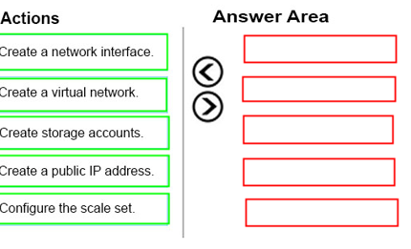
Ans =

Slide 6

New-AzureQuickVM
Creates and provisions a new Azure virtual machine.
the virtual machine. You can create a new Azure service for the virtual machine by specifying either the Location or AffinityGroup parameters, or deploy the new virtual machine into an existing service

Slide 7
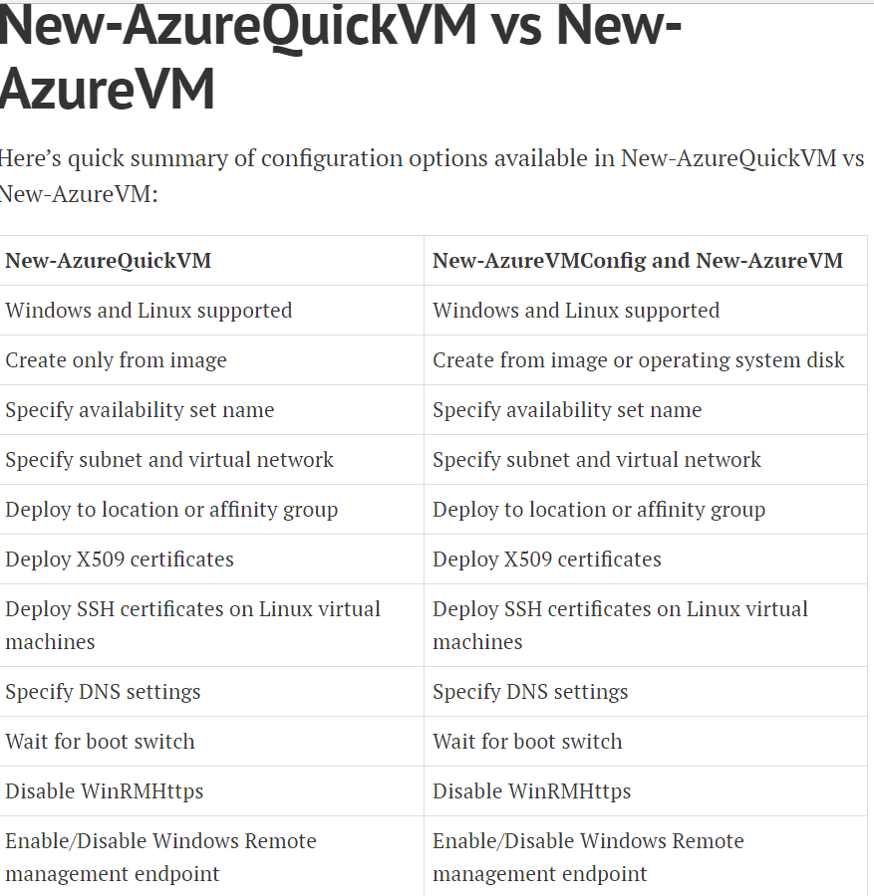

Slide 8
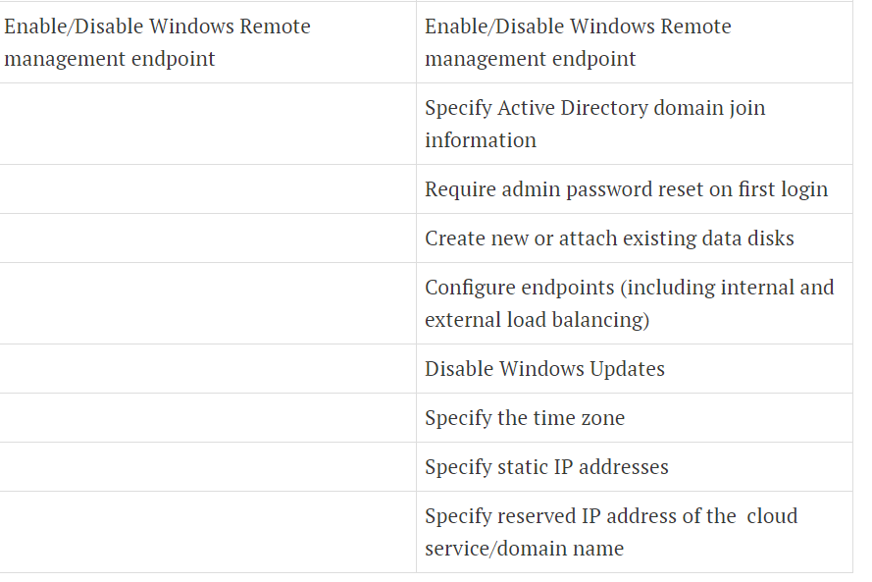

Slide 9
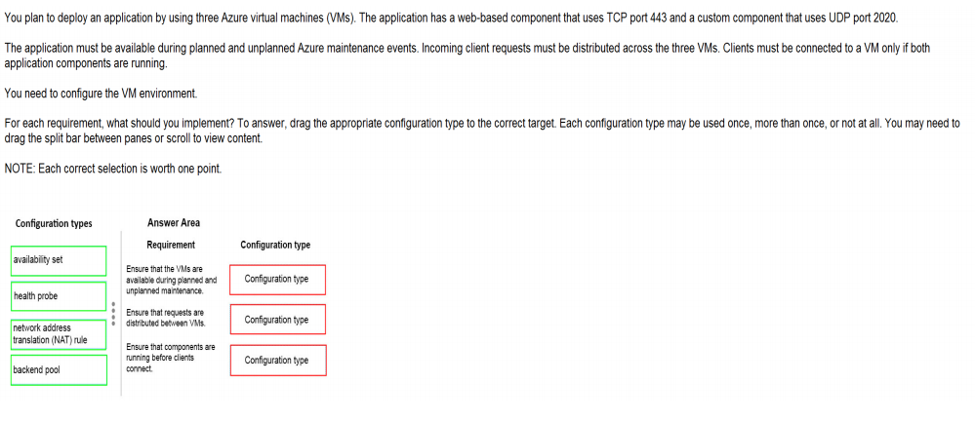
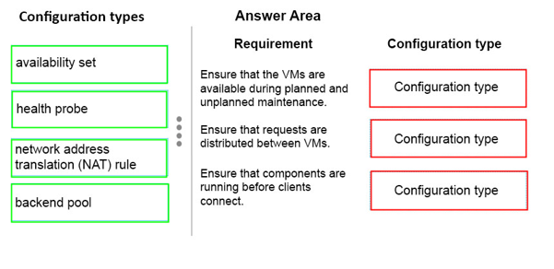
Ans =

Slide 10
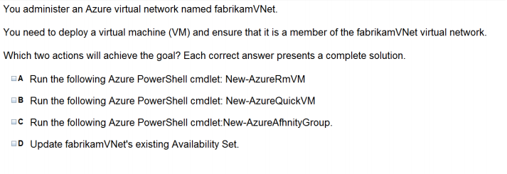

Slide 11
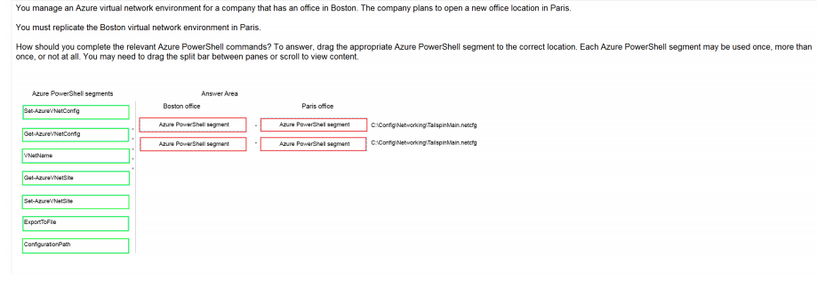
Ans =

Slide 12
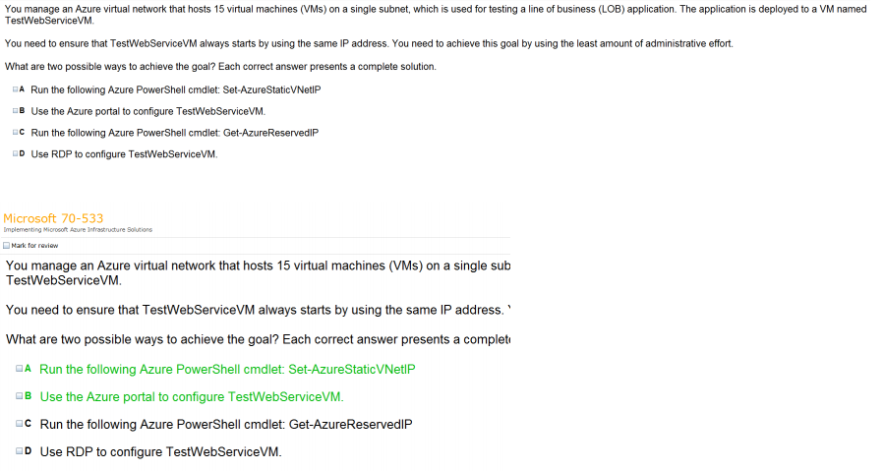
Ans =

Slide 13

Ans = B

Slide 14
Modify Virtual Network

Slide 15
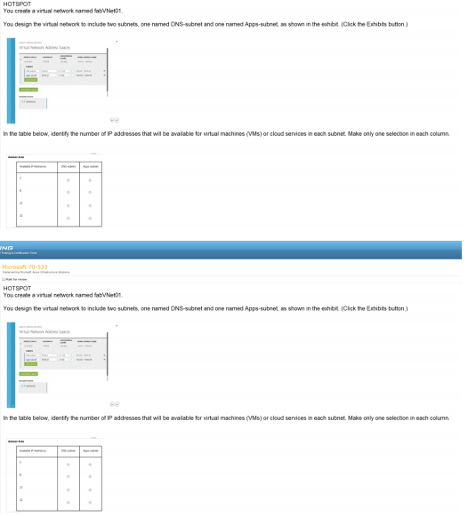
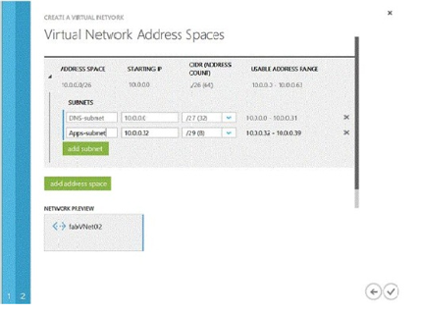
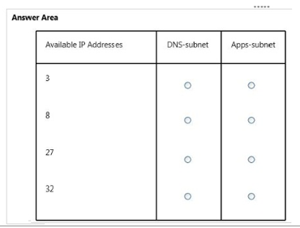

Slide 16
Design & Implement Multi Site and Hybrid Network

Slide 17
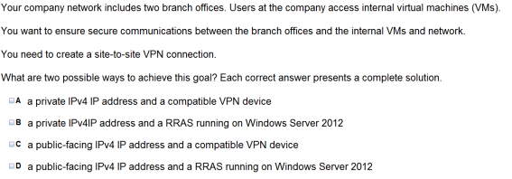

Slide 18


Slide 19
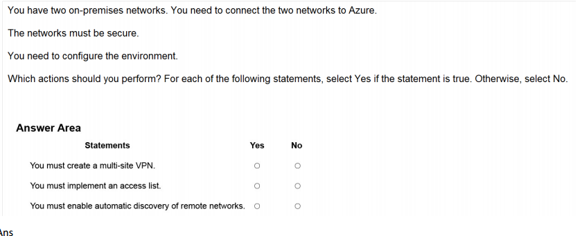
Ans =

Slide 20
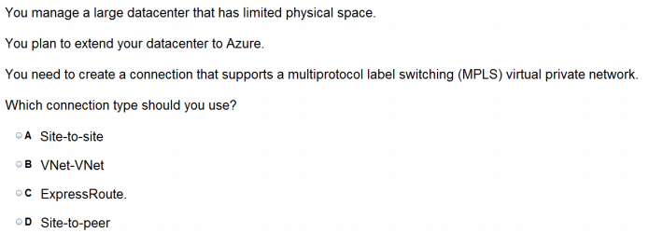

Slide 21
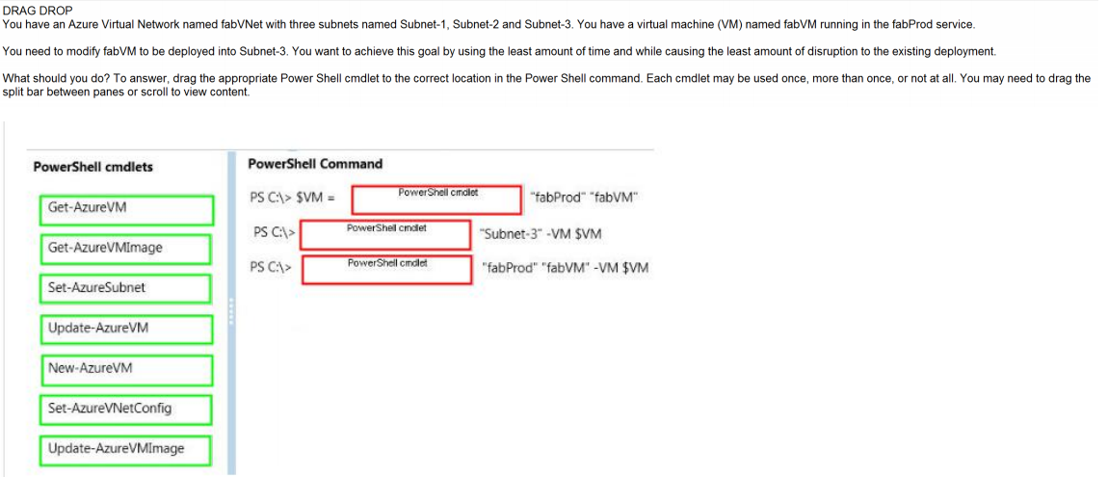
Ans =

Slide 22
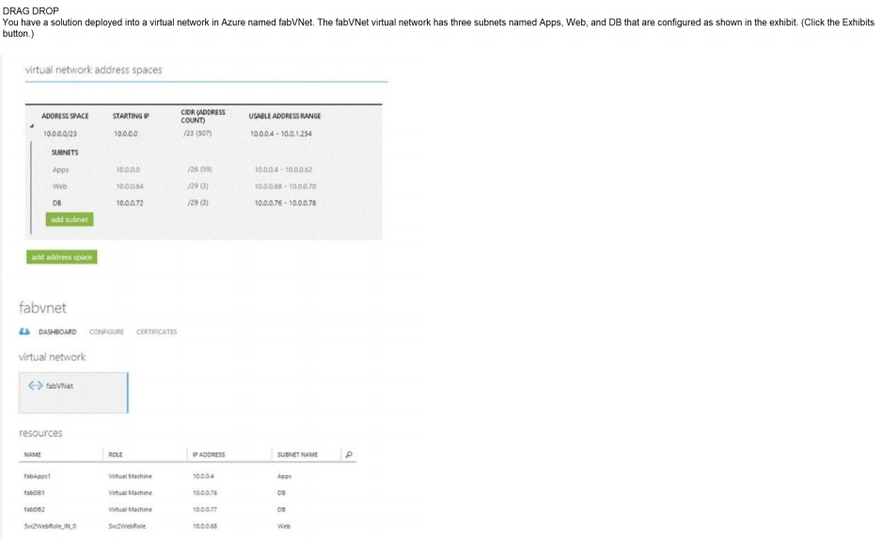
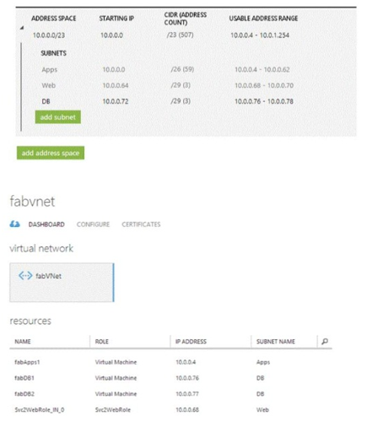
Ans =

Slide 23


Slide 24
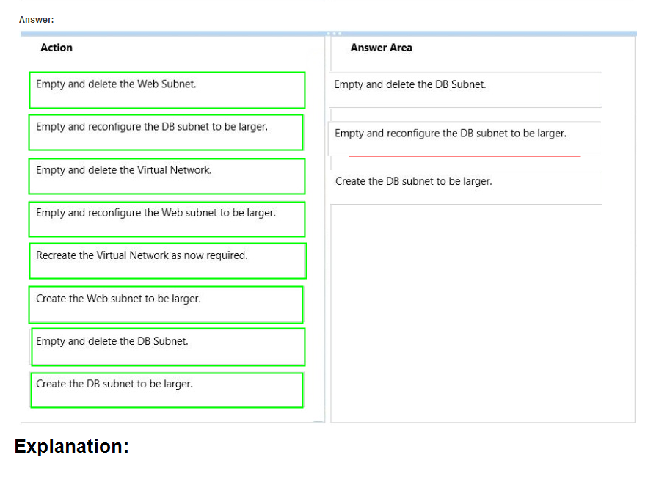

Slide 25

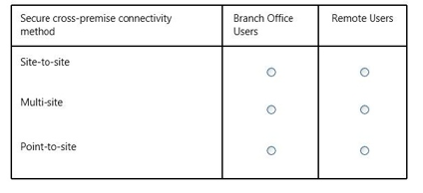
Ans =

Slide 26
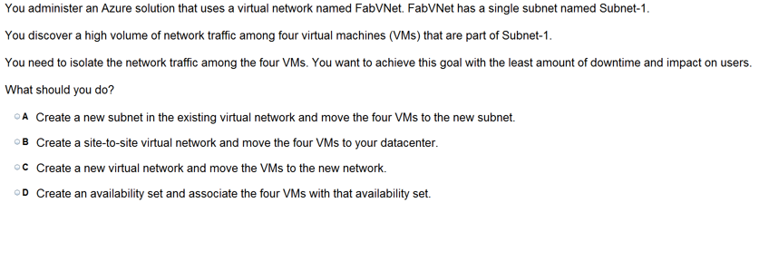

Slide 27

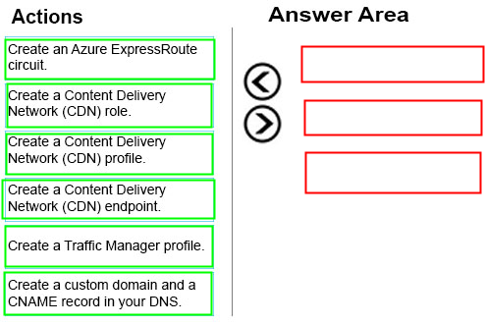
Ans =

Slide 28
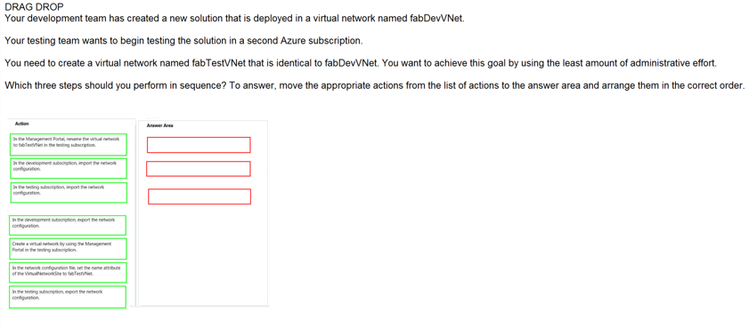
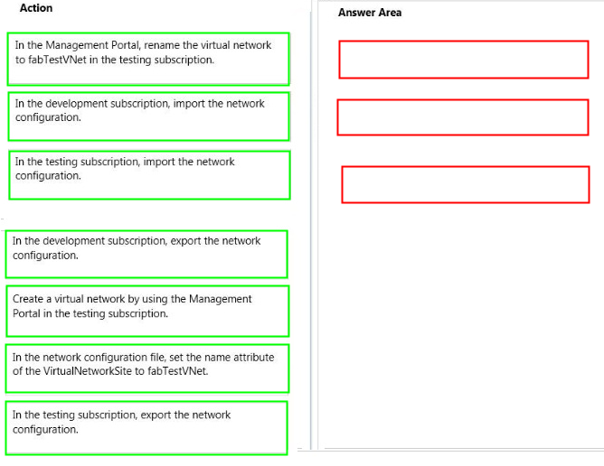
Ans =

Slide 30


Slide 31

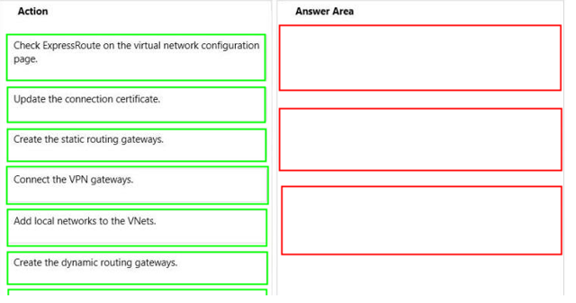
Ans =

Slide 32


